Slide 1
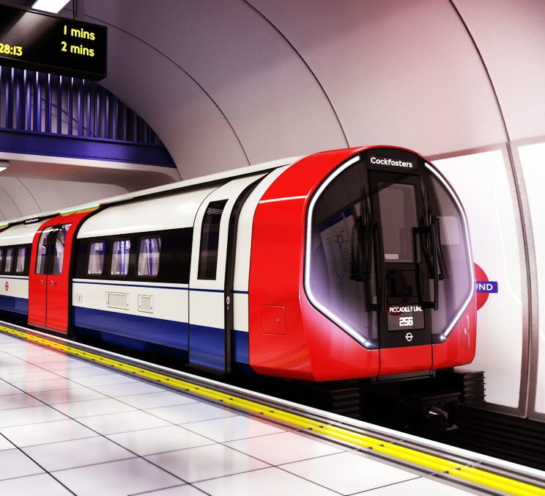
TfL Student Oyster Card App Development
CN6004 – Project Management

Slide 2
AGENDA
CASE STUDY
WBS AND RESOURCE PLANNING
PROJECT NETWORK PLAN
COST ESTIMATION
IMPACT AND CONSIDERATION
CONCLUSION OF THE FEASIBILITY REPORT

Slide 3

TfL’s CASE STUDY
Introduction
Transport for London (TfL) established in 2000, manages London’s transport network, including the underground, buses, DLR, Overground, and Elizabeth Line, ensuring efficient and sustainable travel for millions daily.
Mission of TfL
TfL’s mission is to create a modern accessible, eco-friendly transport network that enhances quality of life and supports London’s growth and prosperity.
Strategies of TfL
TfL aims for 80% of London trips to be made by walking, cycling, and public transport by 2041, focusing on health, sustainability, and collaborative development.

Slide 4
TfL’s CASE STUDY
TfL’s Current Issue:
TfL is handling a cyber security incident affecting customer data, including names, contact details, and bank information of around 5,000 users. They are working with authorities to investigate, secure systems, and support customers, with some Oyster services and online payment functions disrupted.
Our Solution:
We are developing a new Oyster app to support both Travel and Student Oyster Cards, offering:
Card Applications: Apply for new Oyster cards directly through the app.
Purchases: Buy travel cards and bus passes easily.
Transaction Access: View recent transactions at any time.
Travel History: Track journey history for better trip management.
Enhanced Security: A strong firewall to protect customer data and prevent breaches.
This app aims to provide a secure, efficient, and user-friendly experience for all users.

Slide 5
TfL’s CASE STUDY
Our Objectives:
To develop a secure, efficient, and user-friendly mobile app for TfL student Oyster cards.
Specific: Create a secure, user-friendly app with robust firewalls to protect customer data.
Measurable: Achieve 95% user satisfaction and boost app security by 80%.
Achievable: Redesign the app with professional developers for a secure, user-friendly experience.
Relevant: Improve the student Oyster card experience with easy application, payments, and transaction tracking.
Time-bound: Launch the app within 12 months and reduce cyber-attack incidents within 6 months post-launch.

Slide 6
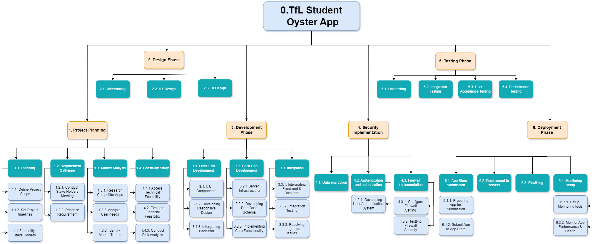
Work Breakdown Structure

Slide 7
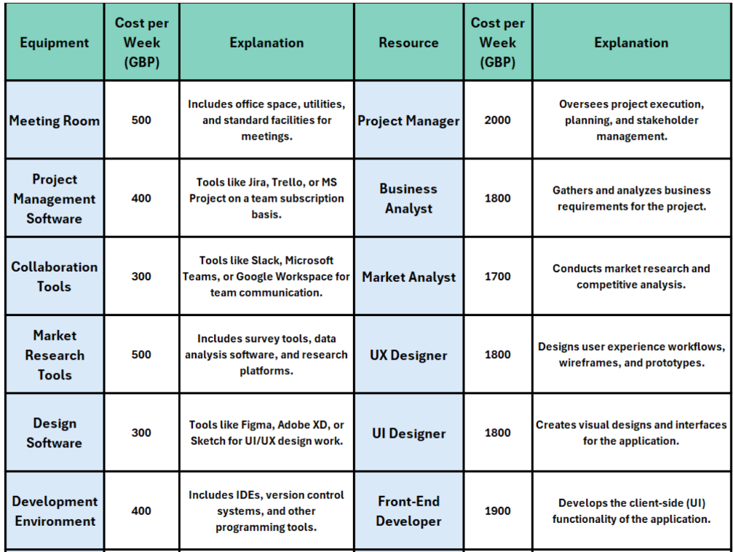
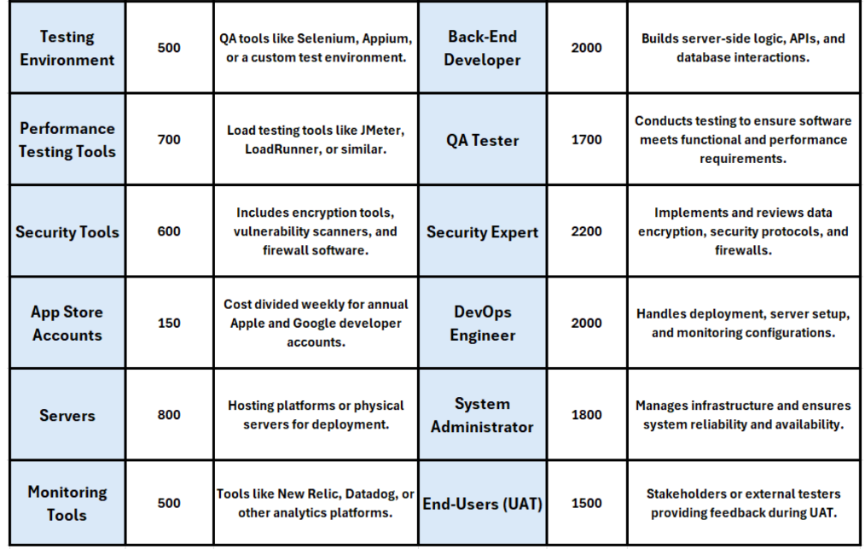
Resource Planning

Slide 8
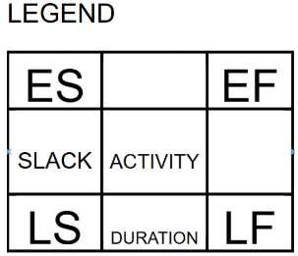
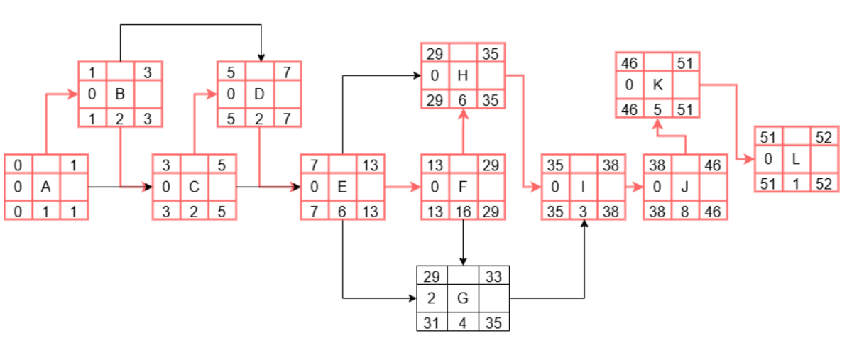
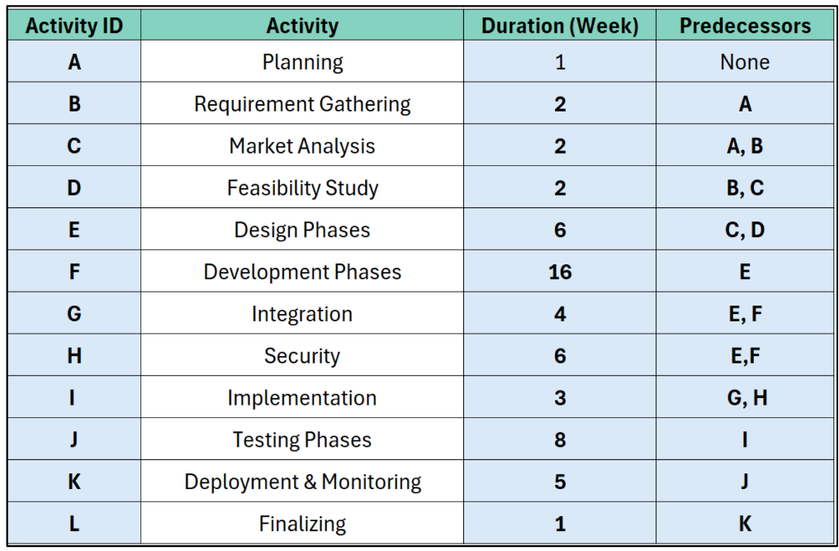
Project Network Plan

Slide 9
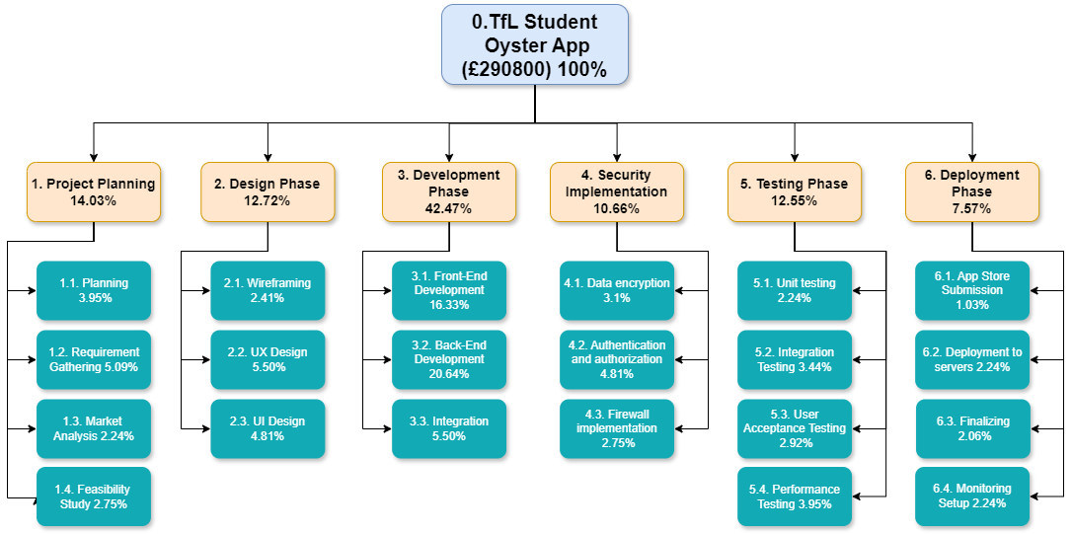
Cost Estimation
Top-Down Cost Estimation:

Slide 10
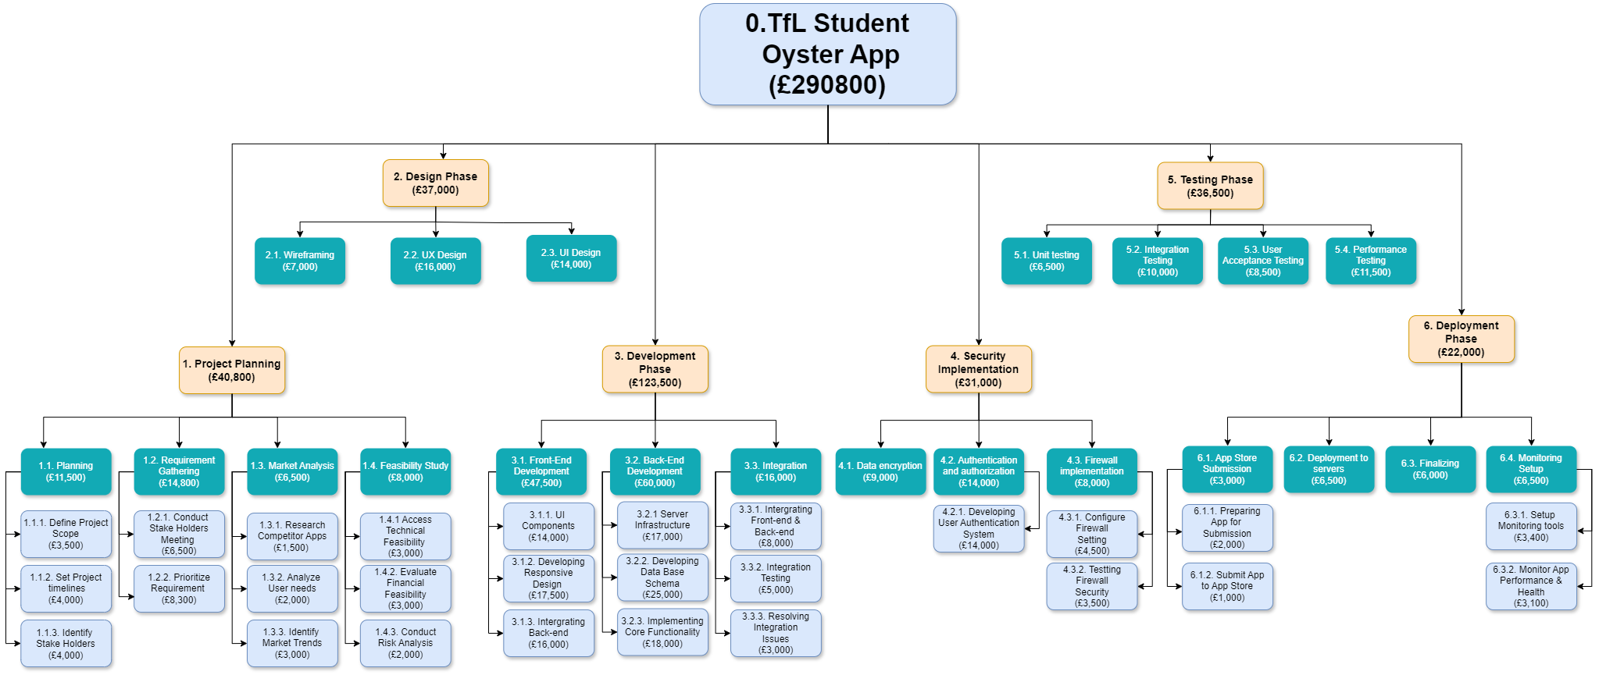
Cost Estimation
Bottom-up Cost Estimation:

Slide 11
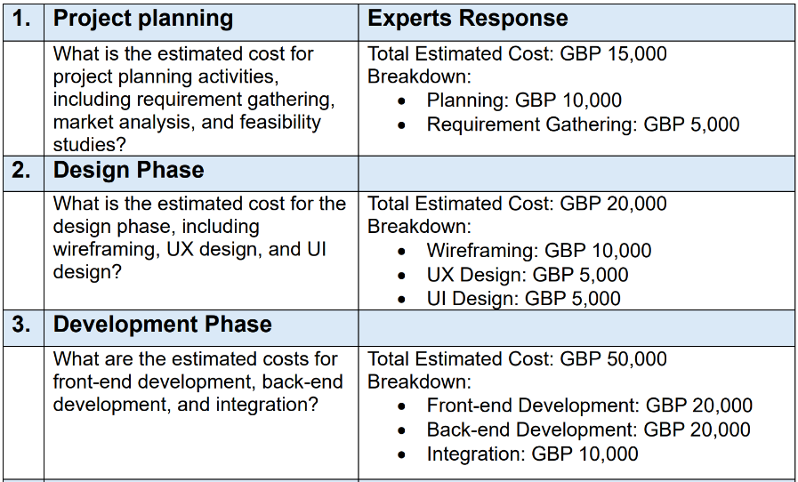
Cost Estimation
Delphi Method:
We effectively applied the Delphi approach in our project to enhance our cost estimation process. Below is some part of Round 1 of it.

Slide 12
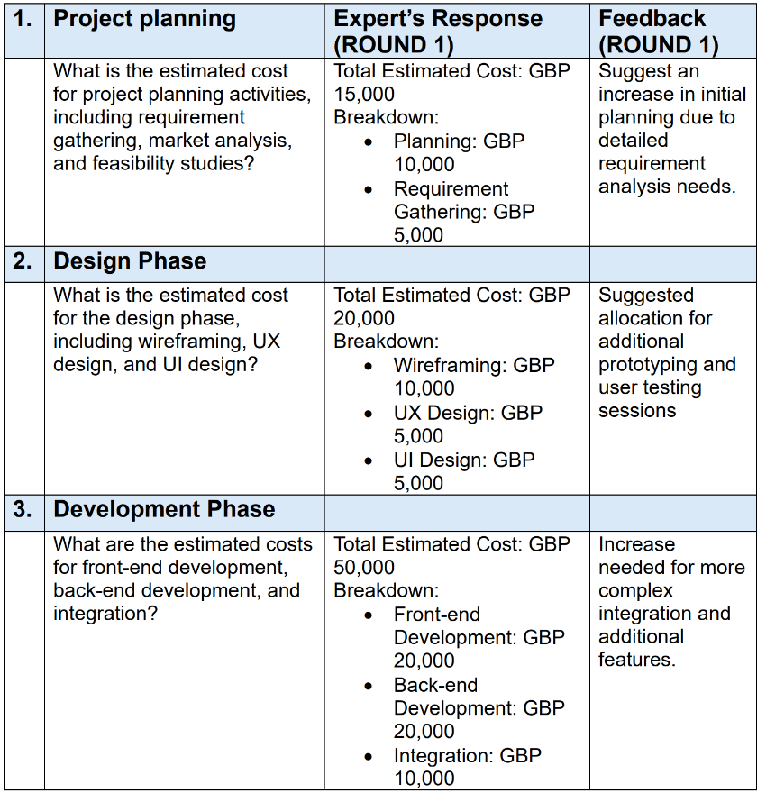
Cost Estimation
Delphi Method:
Here is some of the feedback from the experts after Round 1.

Slide 13
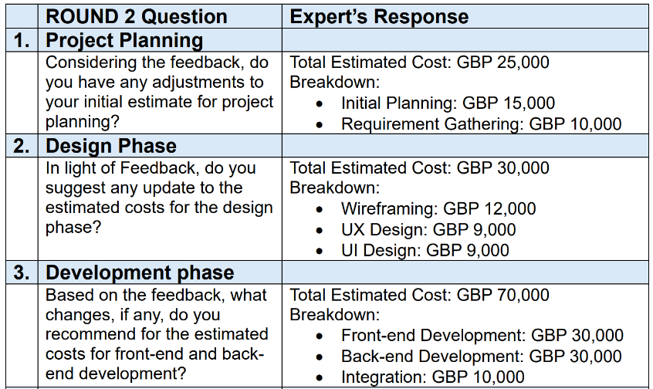
Cost Estimation
Delphi Method:
This is the round 2 Questionnaire of the Delphi method in the basis of round 1 feedback.

Slide 14
Impact & Consideration
Environmental Impact:
Minimizing Paper Waste: Digital cards and e-receipts reduce paper usage and environmental impact.
Energy-Efficient Design: The app will use minimal device resources to extend battery life and reduce energy consumption.
Promoting Sustainable Travel: Features will encourage eco-friendly travel, like off-peak routes and low-carbon options.

Slide 15
Impact & Consideration
Ethical Impact:
Data Privacy & Security: Protect user data (travel, payment, personal info) and comply with GDPR to maintain trust.
Accessibility & Inclusion: Ensure app usability for all, including features like screen-reader support and customizable text.
Avoid Discrimination: Provide offline access to prevent exclusion due to socioeconomic or tech barriers.
Transparency in Data Usage: Communicate data collection, storage, and sharing policies, allowing users to manage their data.

Slide 16
Conclusion of the Feasibility Report
The feasibility study confirms that the development of a new TfL Student Oyster Card app is a practical and beneficial initiative. Key findings include:
Project Viability: The app addresses critical issues like security, accessibility, and sustainability.
Resource Efficiency: Scope, timeline, cost, and resources are well-planned to ensure effective project execution.
Risk Mitigation: Strong organizational structure and risk management strategies reduce potential project risks.
Ethical & Legal Compliance: Ensures GDPR compliance, promotes digital inclusivity and addresses ethical, social, and legal considerations.
Environmental Impact: Reduces paper waste and promotes sustainable travel, supporting TfL’s environmental goals.\
Customer Benefits: Enhances user experience with secure, accessible, and user-friendly features.

Slide 17

THANK YOU ANY QUESTIONS

